Slide 1
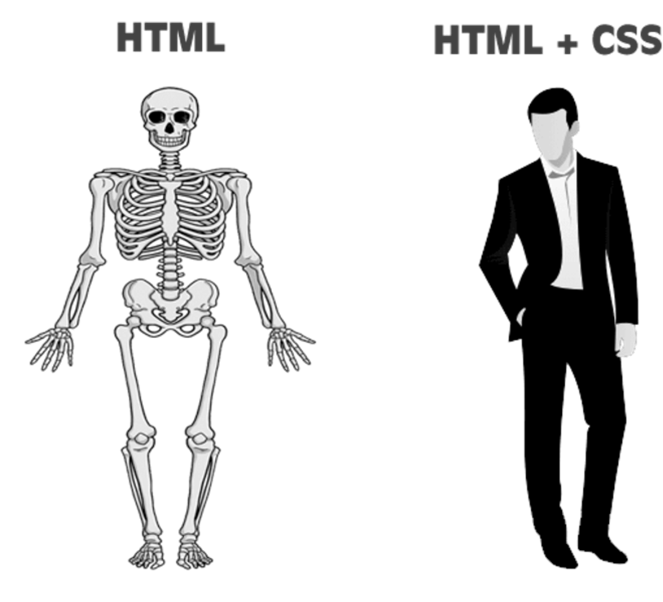

WEB DESIGN
W2 – CSS Concepts

Slide 2

Course Objectives
Use CSS using either inline, internal or external syntax
Manipulate font and color properties on HTML elements
Use various CSS selectors to target HTML elements
    Type Selector h3 {}
    ID Selector #id {}
    Class Selector .class {}
    Grouping Selector h3, .warning {}
Understand the concept of CSS Inheritance

Slide 3

EXPLAIN
What is CSS?
CSS is a language to describe the appearance of an HTML document.
HTML (STRUCTURE)
CSS (APPEARANCE)
body {
background-color: lightblue;
}
h1 {
color: white;
text-align: center;
}
<body>
<h1>My First CSS Example</h1>
</body>

Slide 4
EXPLAIN
How to define a CSS rule?
A CSS rule is composed of a selector and a list of definitions
Selector
p {
color: red;
background-color: blue;
}
Rule
Property
Value

Slide 5
EXPLAIN
How to define a CSS rule?
Don’t forget the required syntax
colon
p {
color: red;
background-color: blue;
}
Brackets
semi-colon

Slide 6
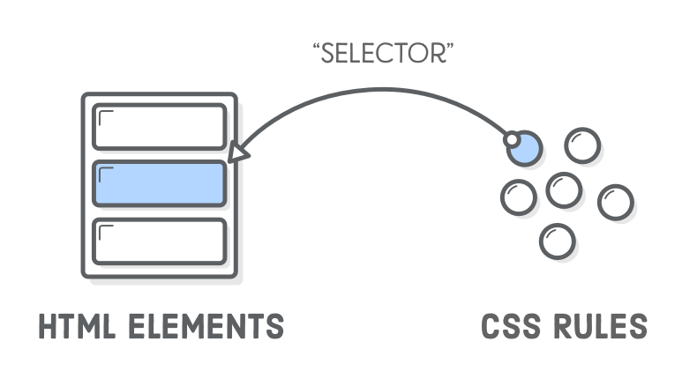
EXPLAIN
What is an CSS selector ?
A CSS selector selects the HTML element(s) you want to style

Slide 7
EXPLAIN
Types of CSS selector ?
Here are some type of selector we will learn during this course
Type Selector h3 {}
ID Selector #id {}
Class Selector .class {}
Grouping Selector h3, .warning {}
Child Selector ul > li {}
Descendant Selector p a {}
Universal Selector * {}
Pseudo-classes p:hover {}

Slide 8
EXPLAIN
Type Selector
A type selector selects all elements of the given type
Element Type
P {
color:red;
}

Slide 9
EXPLAIN
How to link CSS to HTML?
CSS can be linked with the HTML using 3 ways
INLINE WAY
  <h1 style="color:blue; font-size:14px;">Hello</h1>
BLOCK WAY
  Use the tag <style> inside a HTML file
    <head>
    <style> h1 {color:blue; font-size:14px;} </style>
    </head>
EXTERNAL WAY
  Define your rules in a separate file
    <head>
    <link rel="stylesheet" href="style.css">
    </head>>
That s the usual way !

Slide 10


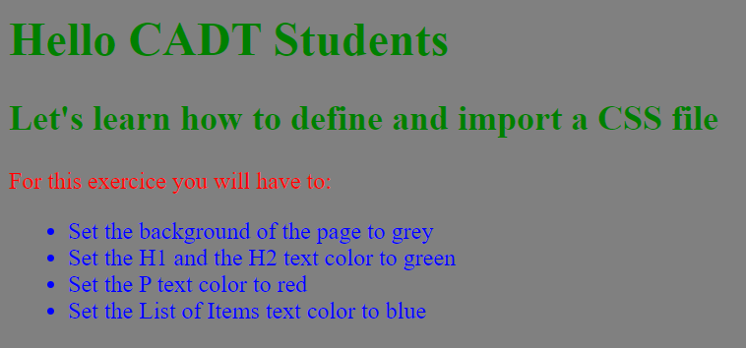
PRACTICE
Activity 1
5 MIN
Read this document on CSS text and background color
Open the HTML file
Write your CSS rules in a separate file
Link the CSS file to the HTML file
Expected result

Slide 11

EXPLAIN
Identifier selectors
ON HTML SIDE
ON CSS SIDE
An identifier can be assigned to an element using the Id attribute
The ID selector selects the element linked to this ID
ID attribute
ID selector
<h1 id=“main-title” >Welcome></h1>
#main-title {
color:orange;
}
ID
An ID should appear only once in a HTML document.

Slide 12
EXPLAIN
Class selectors
ON HTML SIDE
ON CSS SIDE
The class attribute is used to assign a class to an element
The class selector selects all elements linked to the class
Class attribute
Class selector
<h1 class=“title” >Welcome></h1>
.title {
color:orange;
}
Class name

Slide 13
REFLECTION
ID vs CLASSES
When should we use ID?, Classes?
<p id=“my-id” >Semester 1></p>
<p>Semester 2></p>
<p>Semester 3></p>
<p>Semester 4></p>
<p>Semester 5></p>
Semester 1
Semester 2
Semester 3
Semester 4
Semester 5
#my-id {
color:orange;
}
<p class=“warning” >Semester 1></p>
<p>Semester 2></p>
<p>Semester 3></p>
<p>Semester 4></p>
<p class=“warning” >Semester 5></p>
Semester 1
Semester 2
Semester 3
Semester 4
Semester 5
.warning {
color:orange;
}

Slide 14


EXPLAIN
Div HTML Element
The <div> tag defines a division or a section in an HTML document.
DIV is used as a container for HTML elements - which is then styled with CSS.
<div class="pricing-plan">
<div class="pricing-item">
<img src="start.png"/>
<p> BASIC </p>
</div>
<div class="pricing-item">
<img src="premium.png"/>
<p>PREMIUM</p>
</div>
</div>
. pricing-plan {background-color: grey;}
. pricing-item {background-color: white;}
BASIC
PREMIUM

Slide 15

EXPLAIN
Cascade in CSS
In CSS, the term "cascade" means that different styles can be used on the same HTML page
These styles are applied to elements in a strictly defined order.
Cascading rules allow you to resolve situations where multiple styles are specified for a single element.
.warning { }
P, h1 { }
#main-div{ }

Slide 16
REFLECTION
Cascade in CSS
What will be the color of P element?
#myP {
color: blue;
}
.test {
color: green;
}
p {
color: red;
}
<body>
<p id=“myP” class="test">Hello!</p>
</body>

Slide 17
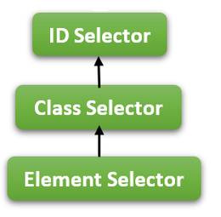
EXPLAIN
Cascade in CSS
P will be blue !
Highest priority
#myP {
color: blue;
}
.test {
color: green;
}
p {
color: red;
}
This rule has the highest priority
Lowest priority

Slide 18
EXPLAIN
Grouping Selectors
The grouping selector selects all the HTML elements with the same style definitions
h1 {
text-align: center;
color: red;
}
h2 {
text-align: center;
color: red;
}
p {
text-align: center;
color: red;
}
h1 , h2, p {
text-align: center;
color: red;
}
Easier to read
Less duplication

Slide 19
REFLECT
We want to set all text color in green
<body>
<h1>Title</h1>
<h2>Heading 2</h2>
<p>Paragraph>
<ul>
<li>Item 1</li>
<li>Item 2</li>
<li>Item 3</li>
</ul>
</body>
Title
Heading 2
Paragraph
Item 1
Item 2
Item 3
Can we find a better way than this code?
h1,h2,h3,p,a,strong,q {
color: green;
}

Slide 20
EXPLAIN
Understanding CSS Inheritance
CSS inheritance is a mechanism that allows certain properties of a parent element to be automatically inherited by its child elements
The body has the property color green
html
body{
color: green;
}
head
body
title
h1
h2
p
ul
li
li
li
All the inherited child will also get this property

Slide 21

QUIZ !
The teacher starts the quiz and clicks through the questions.
The students answer the questions within the given time.
At the end of the quiz, a leaderboard with the results for the entire group will be generated.
ARE YOU READY ?

Slide 22
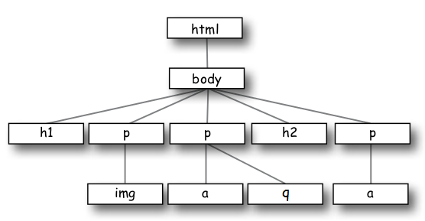
Q1
Which elements will be Sans-Serif ?
p {
font-family: sans-serif
}

Slide 23
Q1
Which elements will be Sans-Serif ?
p {
font-family: sans-serif
}

Slide 24
Q2
Which elements will be green ?
body {
color: green;
}
p {
color: black;
}

Slide 25
Q2
Which elements will be green ?
body {
color: green;
}
p {
color: black;
}

Slide 26
Q3
What will be the color of my h1 ?
h1{
color = green;
}
#id1 {
color = blue;
}
.orange{
color = orange;
}
<body>
<h1 id=“id1” class=“orange”>Hello</h1>
</body>
1
blue
3
orange
2
green
4
All colors

Slide 27
Q3
What will be the color of my h1 ?
h1{
color = green;
}
#id1 {
color = blue;
}
.orange{
color = orange;
}
<body>
<h1 id=“id1” class=“orange”>Hello</h1>
</body>
1
blue
3
orange
2
green
4
All colors

Slide 28
Q4
Given the following HTML, which CSS rule will apply styles to all elements with the class "highlight"?
<p class="highlight">Important text</p><span class="highlight">Another important text</span>
A) highlight { background-color: yellow; }
B) #highlight { background-color: yellow; }
C) .highlight { background-color: yellow; }
D) *highlight { background-color: yellow; }

Slide 29
Q4
Given the following HTML, which CSS rule will apply styles to all elements with the class "highlight"?
<p class="highlight">Important text</p><span class="highlight">Another important text</span>
A) highlight { background-color: yellow; }
B) #highlight { background-color: yellow; }
C) .highlight { background-color: yellow; }
D) *highlight { background-color: yellow; }

Slide 30
Q5
Which element(s) will have a red font color ?
body {
color: black;
}
.text {
color: red;
}
#main {
color: blue;
}
<body>
<div id="main" class="text">
<p>This is a paragraph.</p>
</div>
</body>
A) The <div>
B) The <div> and the <p>
C) The <p>
D) None

Slide 31
Q5
Which element(s) will have a red font color ?
body {
color: black;
}
.text {
color: red;
}
#main {
color: blue;
}
<body>
<div id="main" class="text">
<p>This is a paragraph.</p>
</div>
</body>
A) The <div>
B) The <div> and the <p>
C) The <p>
D) None
The <div id="main" class="text"> element and its child <p> will both inherit the color blue from the #main rule.

Slide 32
Q6
Which element(s) will have a green text color ?
<body>
<div>
<p class="highlight">Monday.</p>
<p>Tuesday</p>
</div>
</body>
p {
  color: green;
}
.highlight {
color: red;
}
A) Both paragraphs
B) Only the paragraph with the class "highlight"
C) Only the normal paragraph
D) Neither paragraph

Slide 33
Q6
Which element(s) will have a green text color ?
<body>
<div>
<p class="highlight">Monday.</p>
<p>Tuesday</p>
</div>
</body>
p {
  color: green;
}
.highlight {
color: red;
}
A) Both paragraphs
B) Only the paragraph with the class "highlight"
C) Only the normal paragraph
D) Neither paragraph

Slide 34
Q7
What is the rule to display Wednesday in red?
<body>
<h1>Monday</h1>
<div>
<h1>Tuesday</h1>
</div>
<div class=“selection”>
<h1>Wednesday</h1>
</div>
</body>
1
3
div h1 { color : red;}
.selection h1 {color : red;}
2
div , h1{color : red;}
4
.selection, h1{color : red;}

Slide 35
Q7
What is the rule to display Wednesday in red?
<body>
<h1>Monday</h1>
<div>
<h1>Tuesday</h1>
</div>
<div class=“selection”>
<h1>Wednesday</h1>
</div>
</body>
1
3
div h1 { color : red;}
.selection h1 {color : red;}
2
div , h1{color : red;}
4
.selection, h1{color : red;}

Slide 36
Congratulations !
You should now master those concepts
Apply inline, internal, and external CSS styles
Manipulate font and color properties on HTML elements
Use various CSS selectors to target HTML elements
    Type Selector h3 {}
    ID Selector #id {}
    Class Selector .class {}
    Grouping Selector h3, .warning {}
Understand the concept of CSS Inheritance

Slide 37



WRAPPING THE LESSON
3-2-1 Challenge
List three things you learned today.
List two questions you still have.
List one aspect of the lesson or topic you enjoyed.

Slide 38


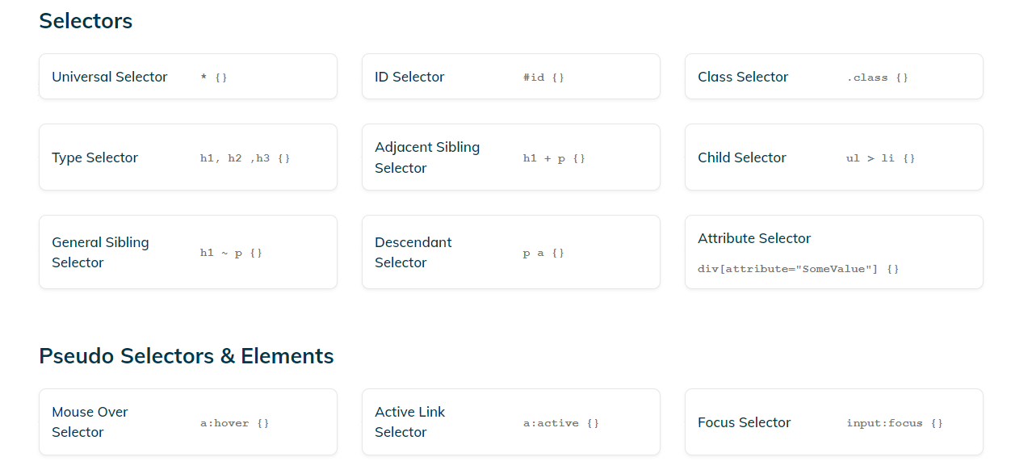
HAVE A LOOK !
https://adam-marsden.co.uk/css-cheat-sheet
A nice summary of everything you need to know on CSS

Slide 39


TODO AFTER
After this session !
PART 1 – LEARN MORE !
PART 2 – PLAY !
Read more about CSS Selectors
https://web.dev/learn/css/selectors
Read the CSS Cheat Sheet
https://adam-marsden.co.uk/css-cheat-sheet
Another great article about CSS Selectors
https://css-tricks.com/css-selectors/
Go as far as you can on this game
https://flukeout.github.io/

